Slide 1
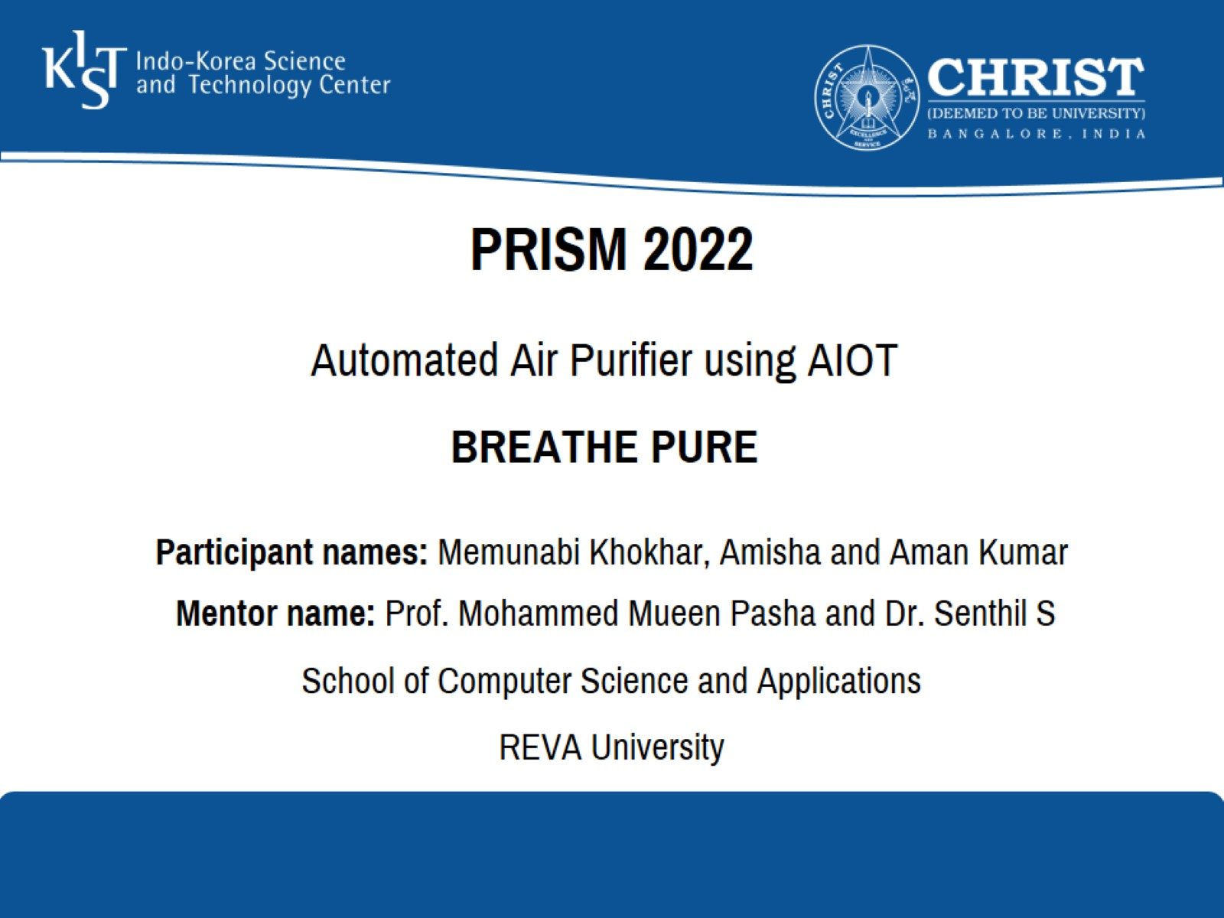
PRISM 2022

Slide 2
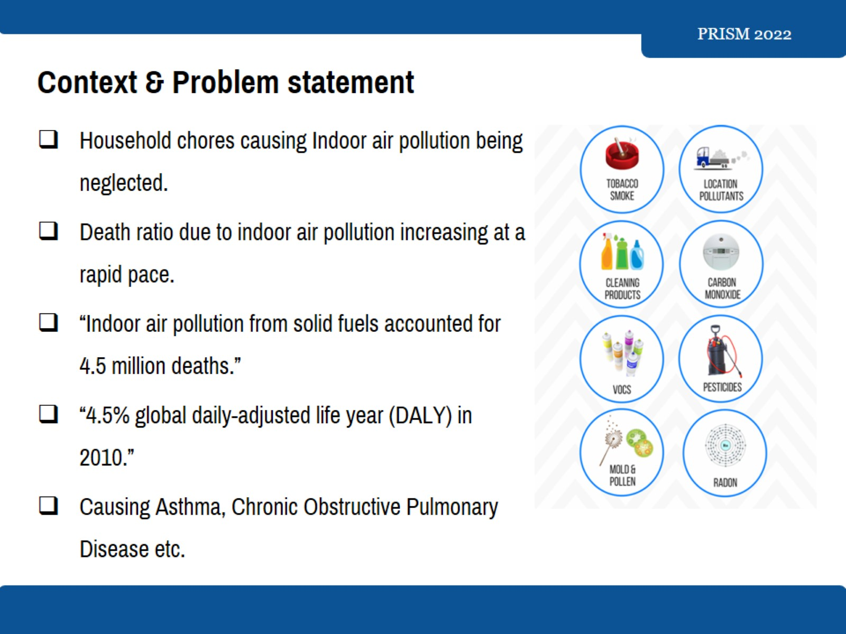
Context & Problem statement

Slide 3
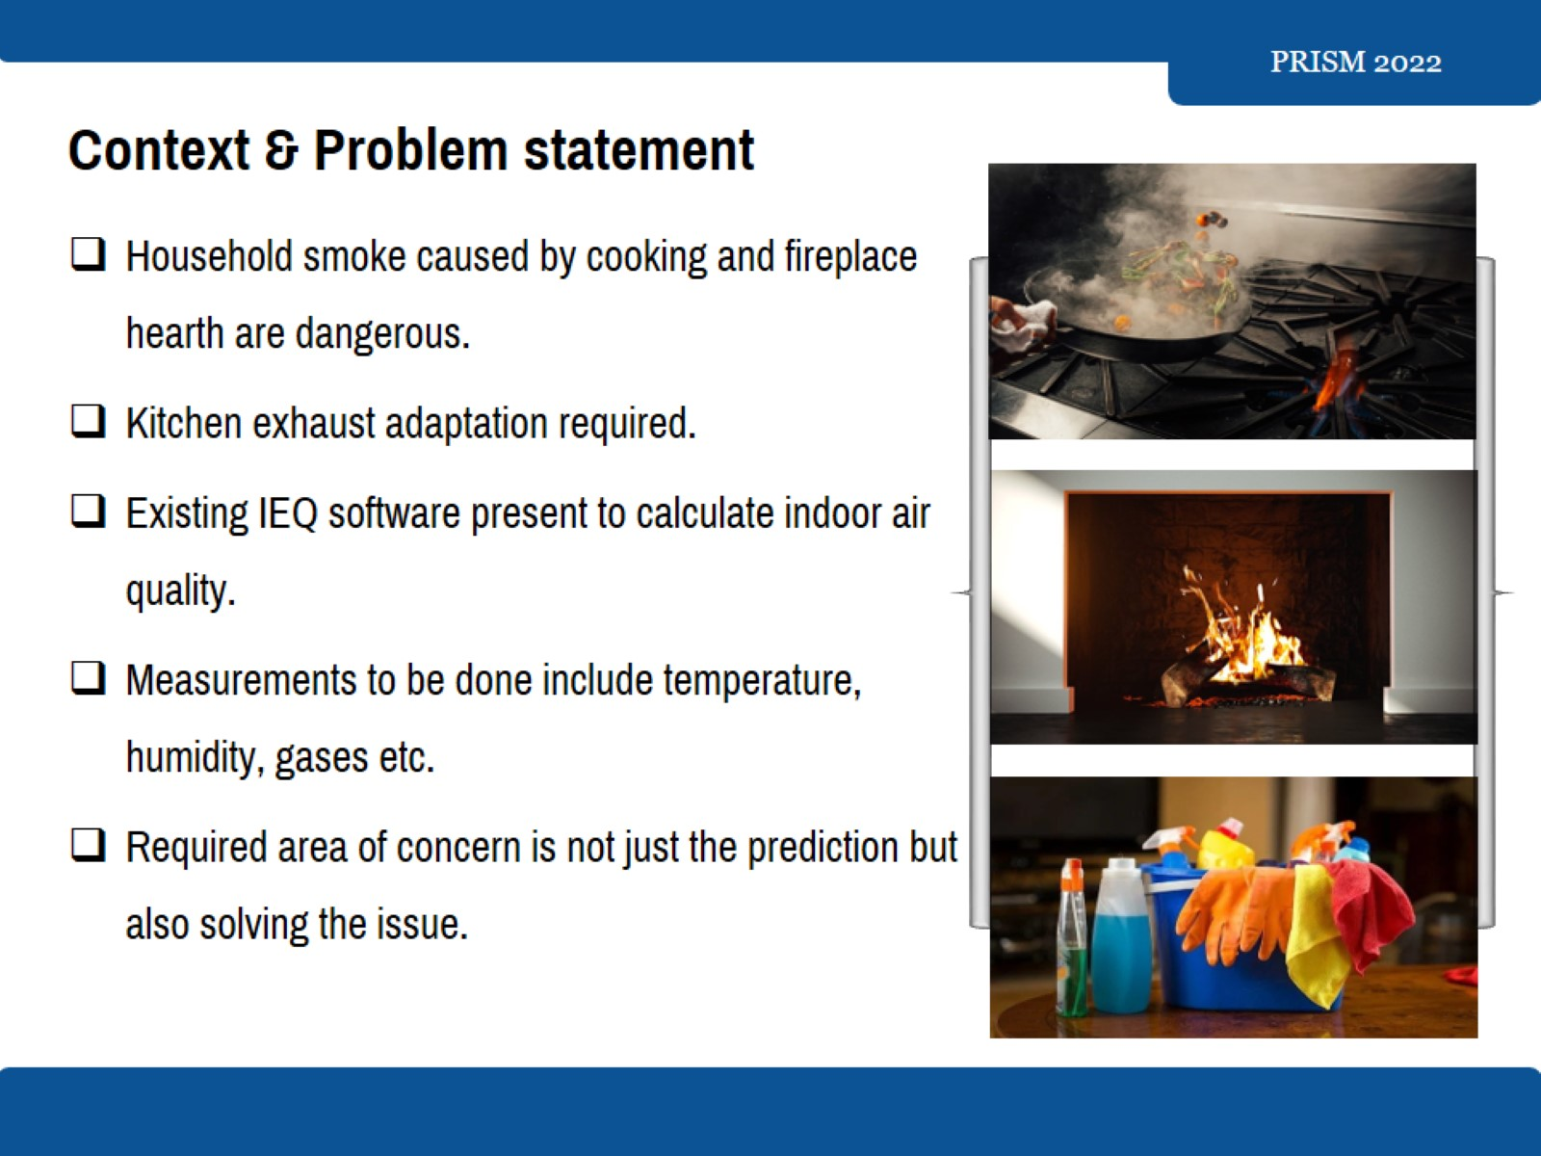
Context & Problem statement

Slide 4
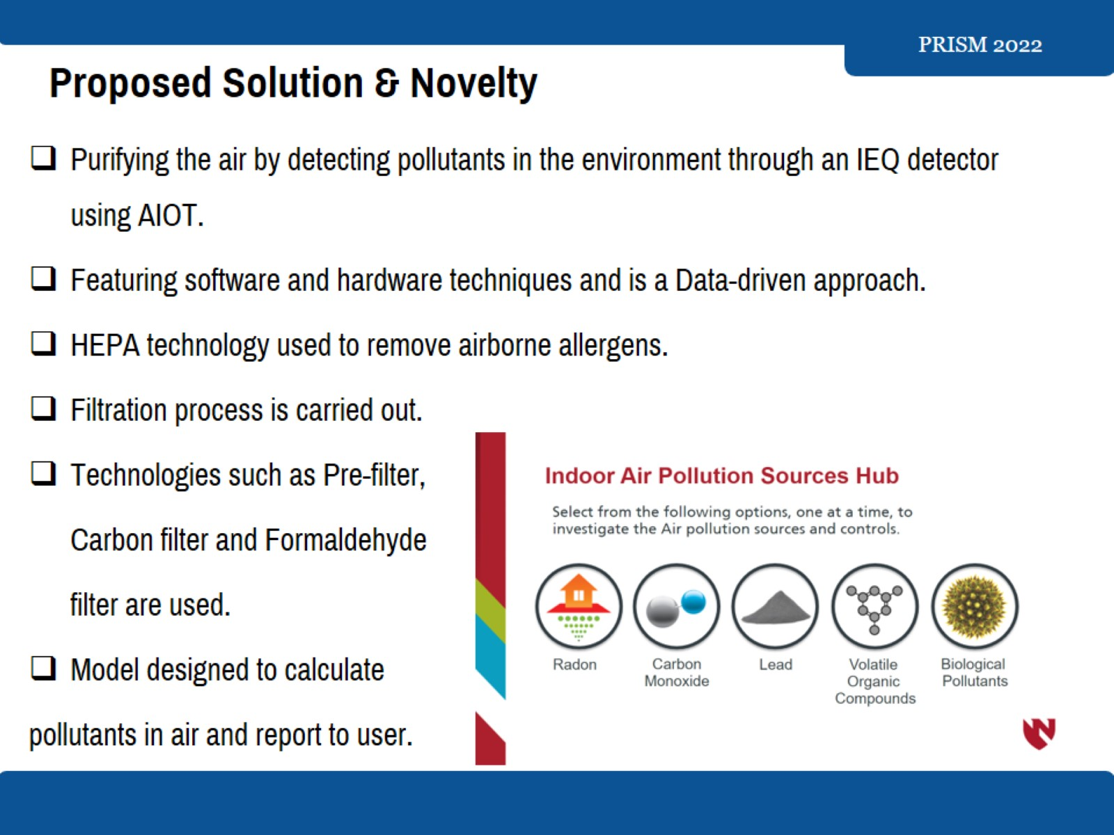
Proposed Solution & Novelty

Slide 5
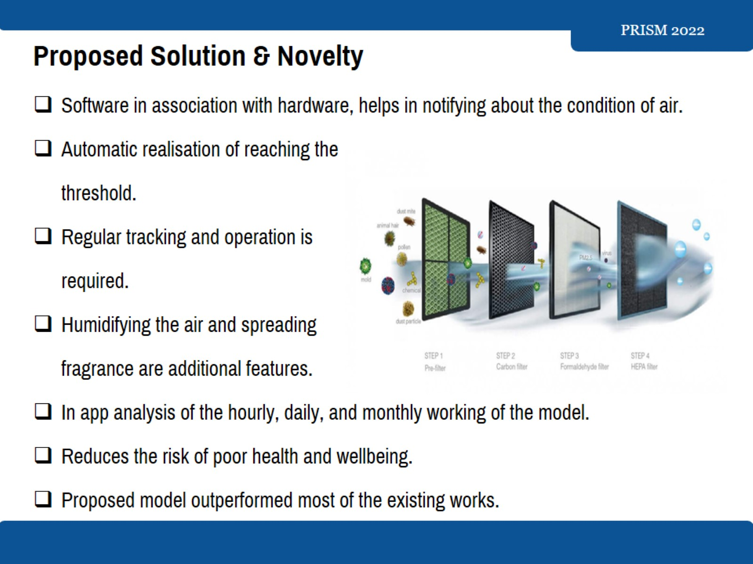
Proposed Solution & Novelty

Slide 6
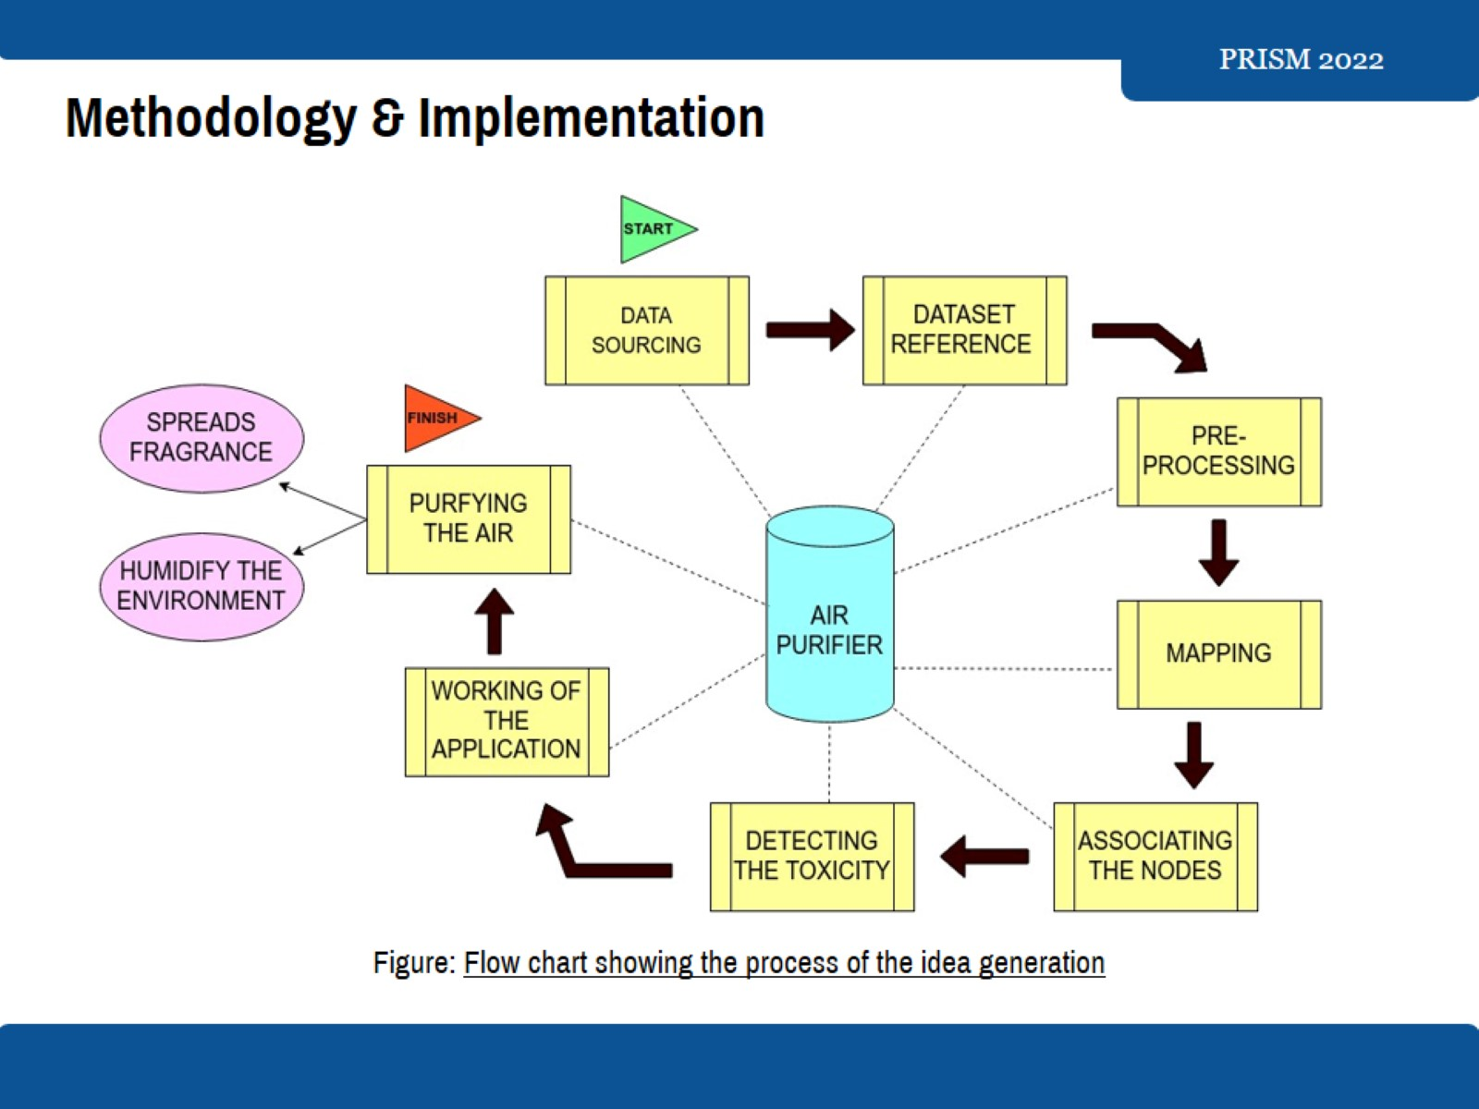
Methodology & Implementation

Slide 7
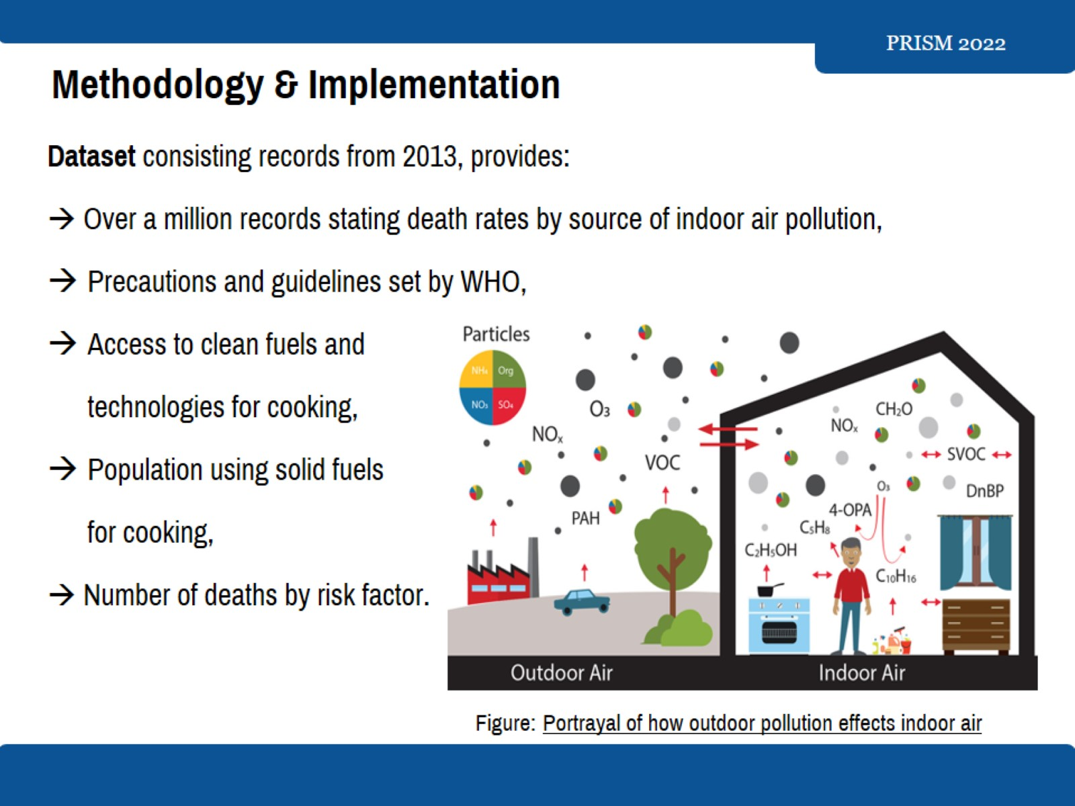
Methodology & Implementation

Slide 8
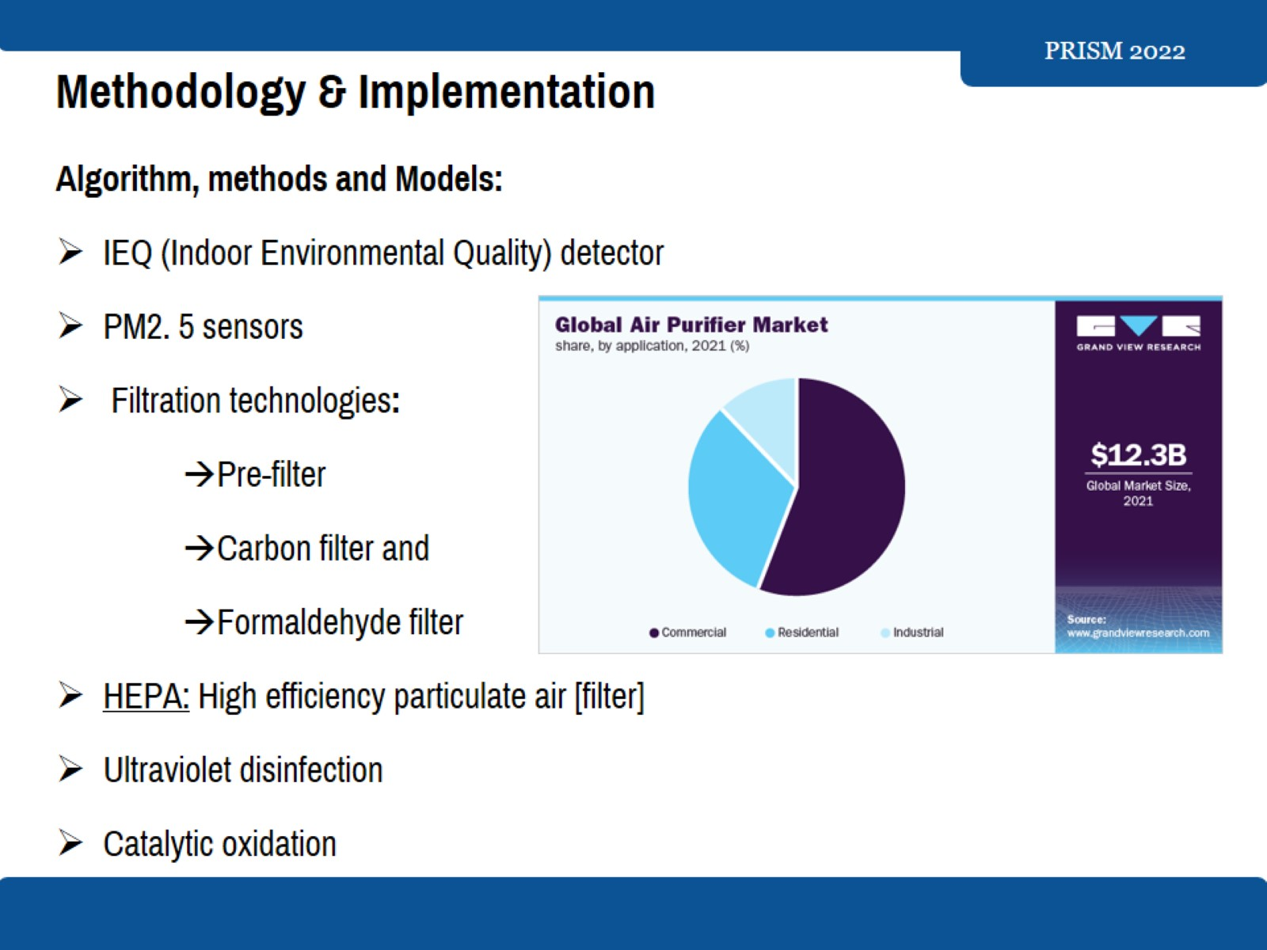
Methodology & Implementation

Slide 9
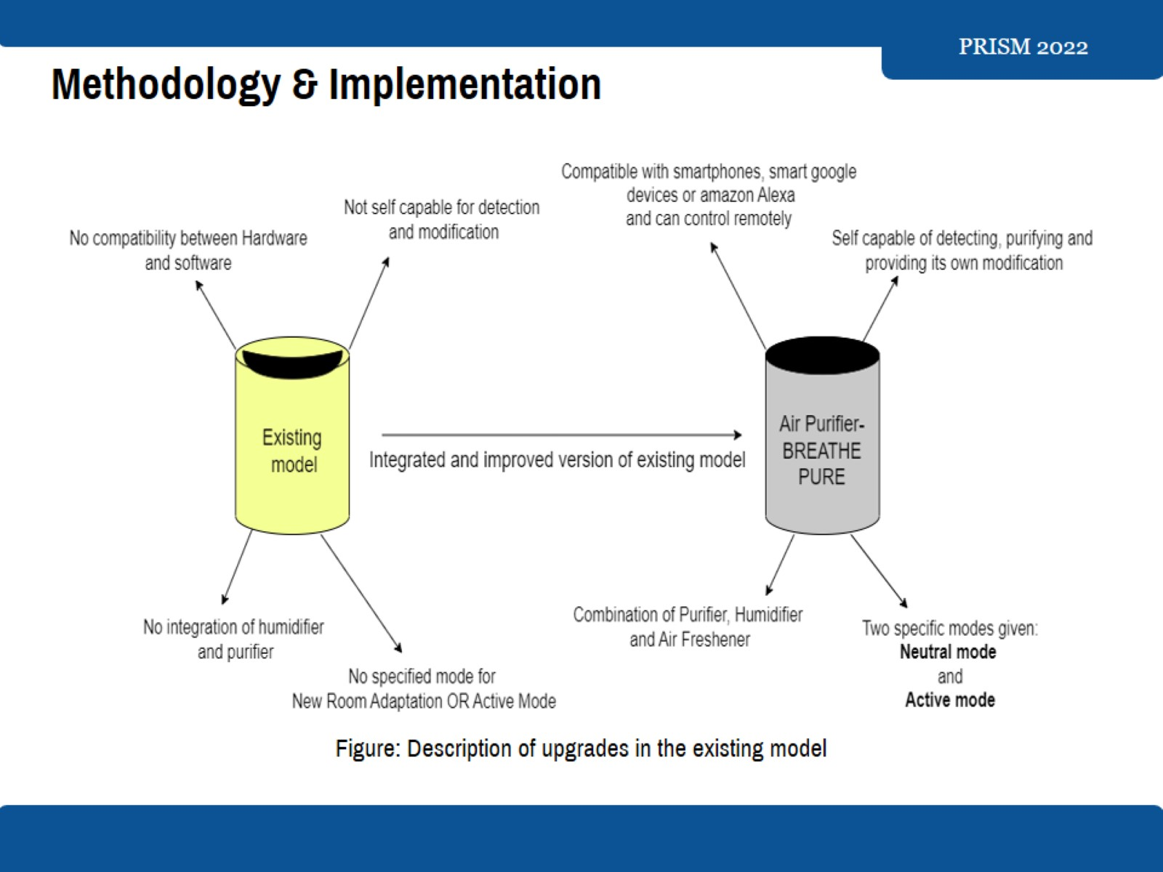
Methodology & Implementation

Slide 10
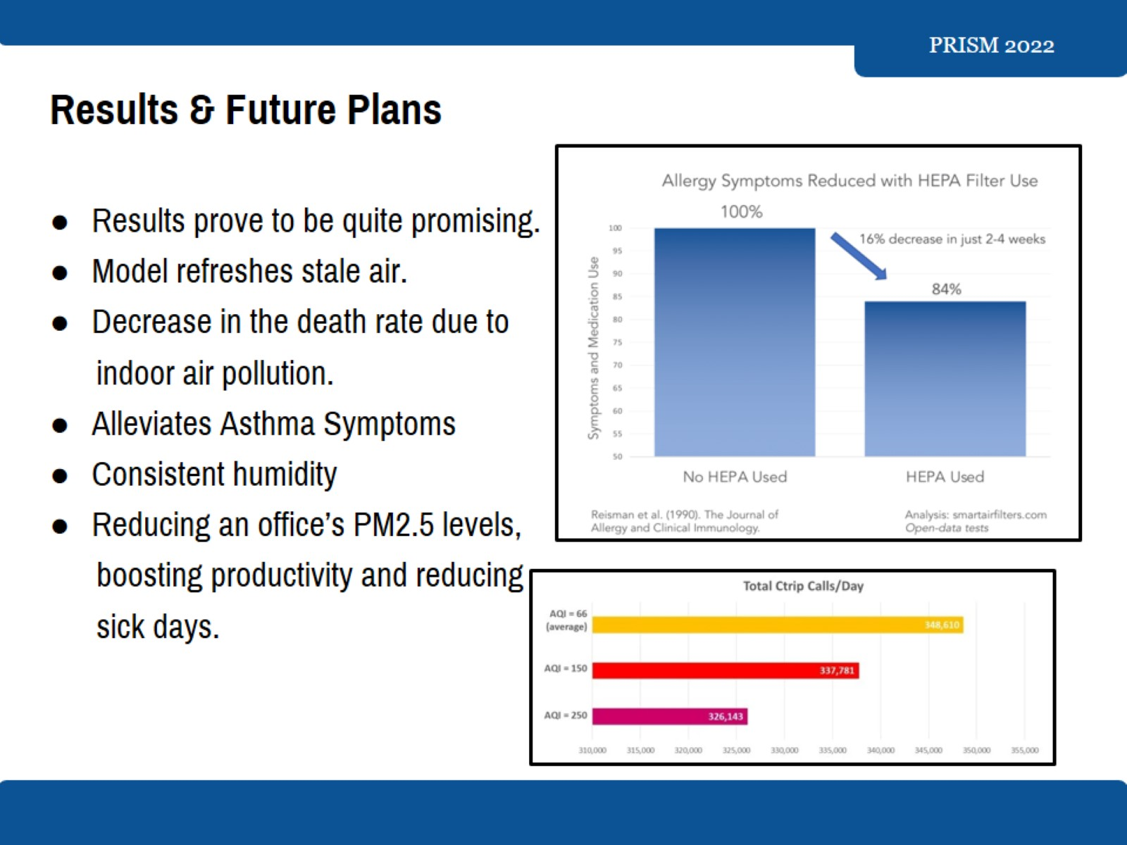
Results & Future Plans

Slide 11
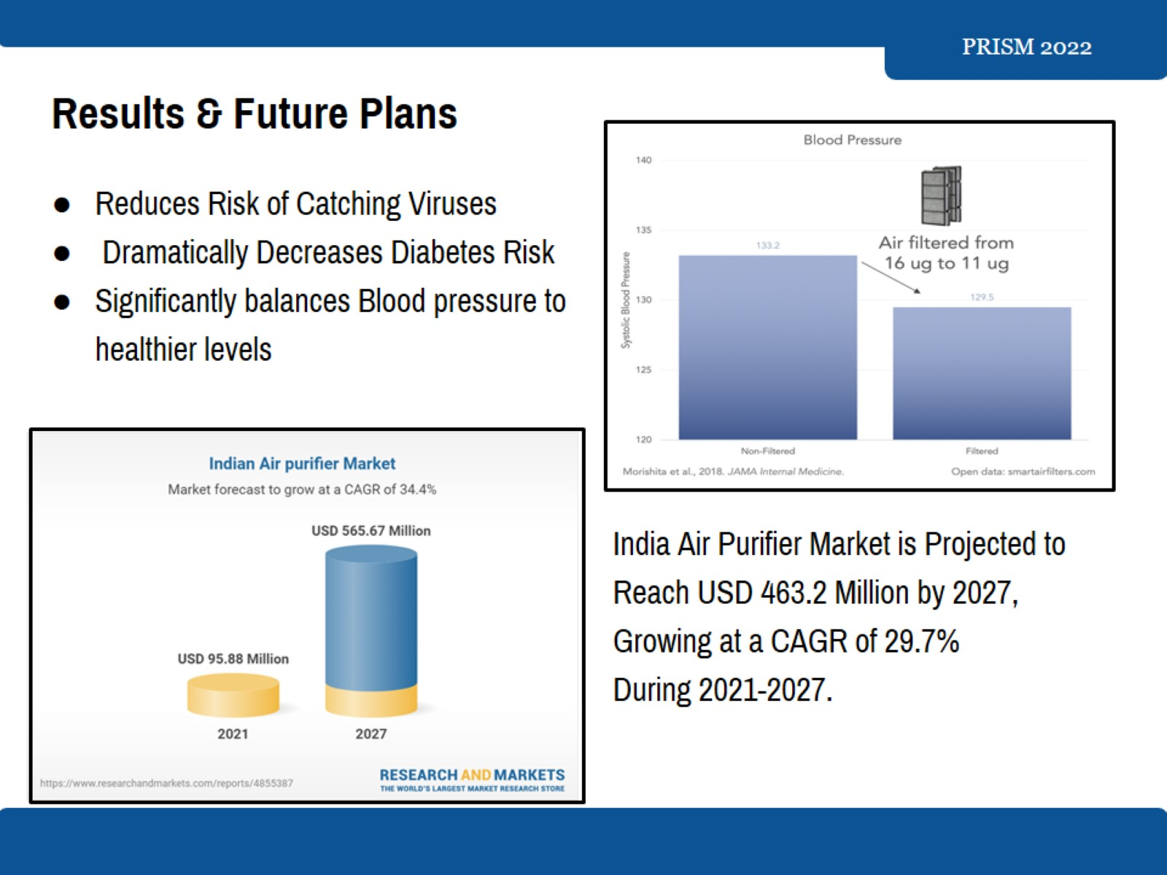
Results & Future Plans

Slide 12
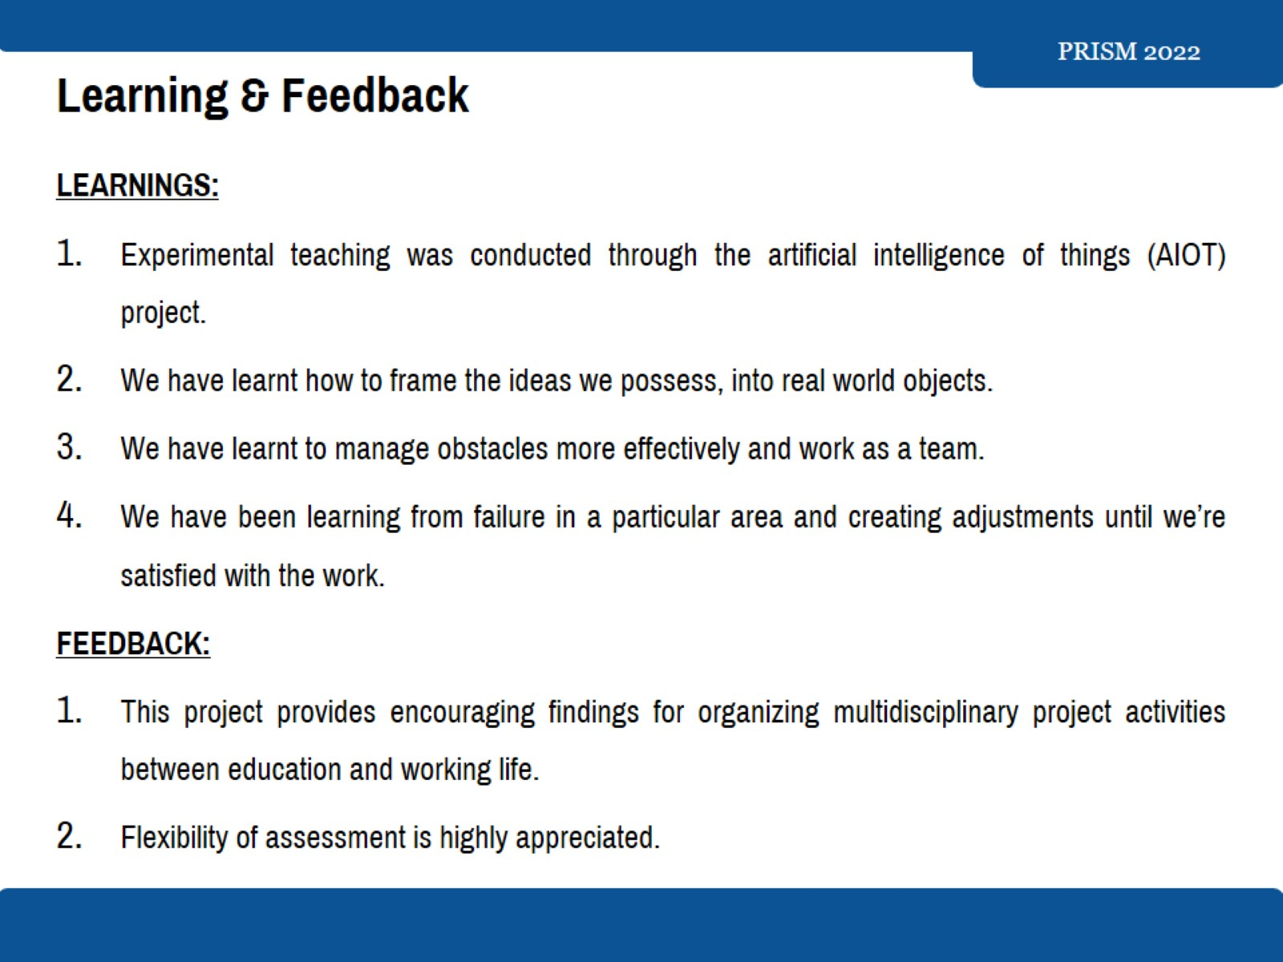
Learning & Feedback

Slide 13


